Slide 1
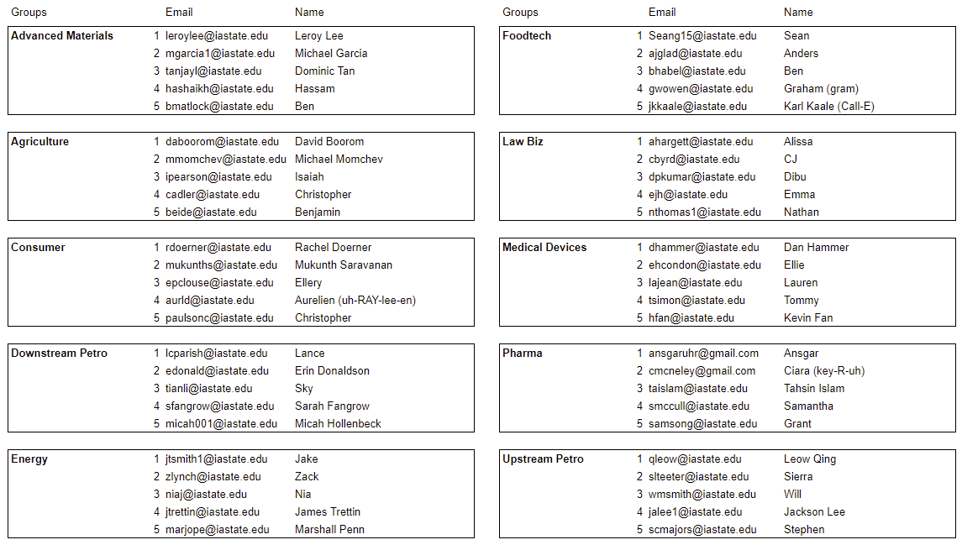
Startup Teams – Fall 2019 – ChE 310
Notes:
Explain why you have them sit in groups – important to meet new classmates, you are learning a foreign language this term, need to work together.

Slide 2
ChE 310 – Computational Methods in Chemical Engineering
Instructor: Dr. Nigel Reuel / 3051 Sweeney / reuel@iastate.edu
Assistant: Adam Carr/ acarr4@iastate.edu
Office hours: 2126 Sweeney
Monday 2:30 to 4 (LR), Tuesday 3:30 to 5 (NR), and Wednesday 4-6 (AC)

Slide 3
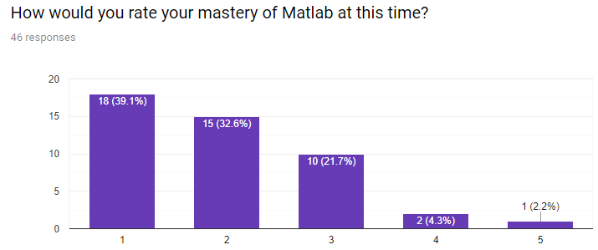
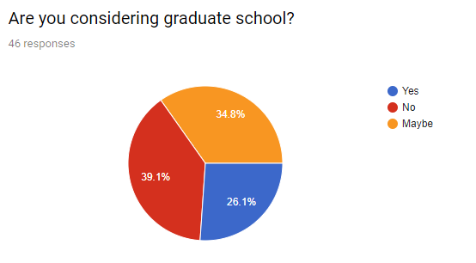
Class Survey
Notes:
https://www.wordclouds.com/

Slide 4
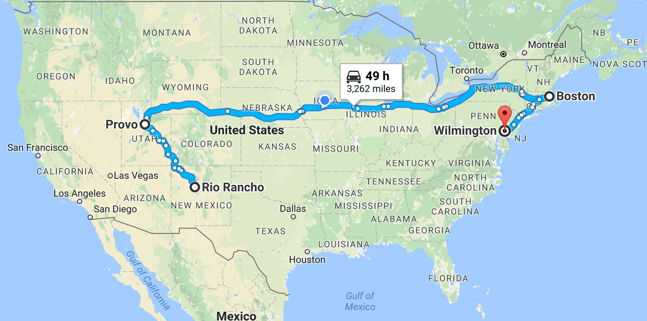
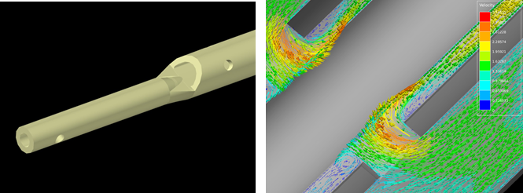
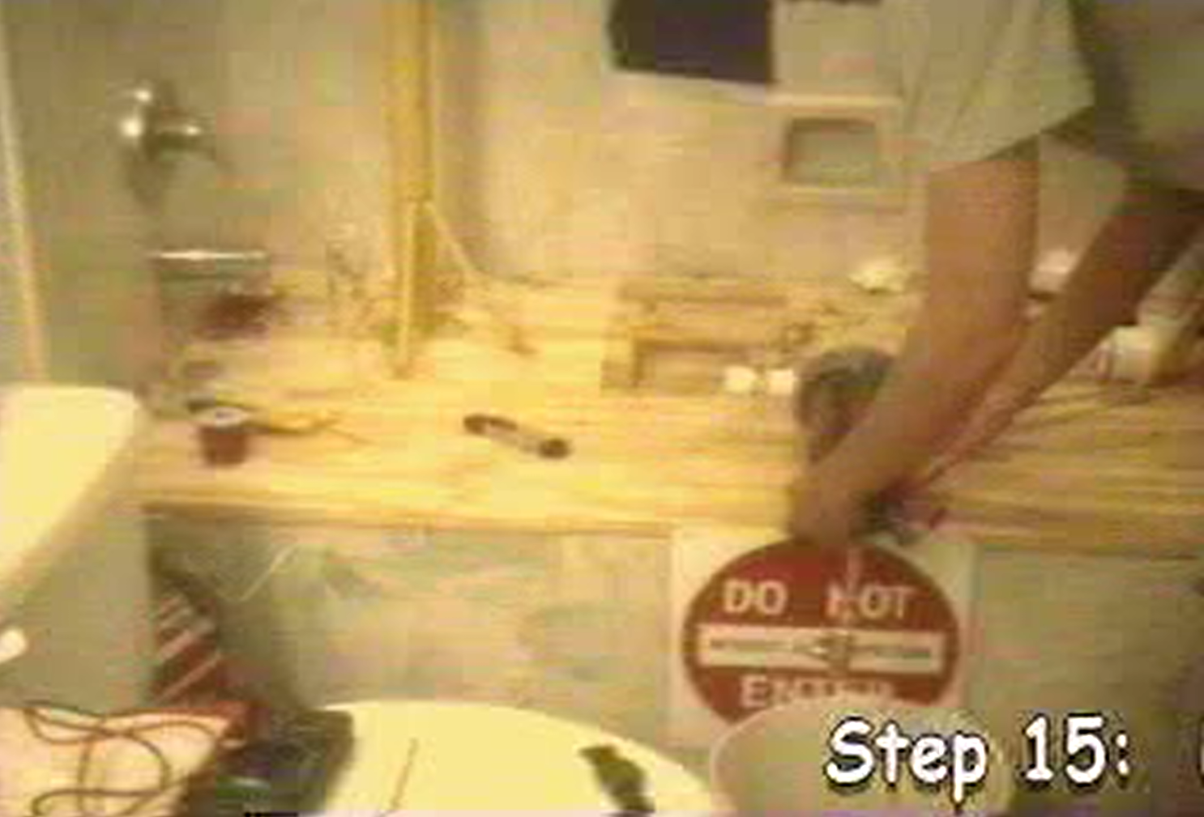
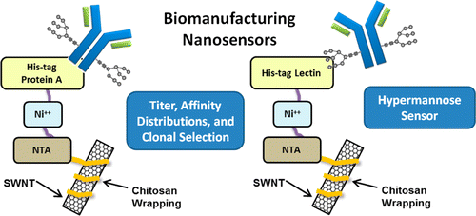
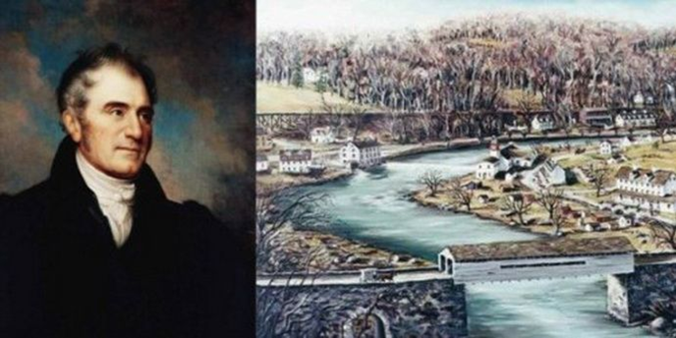
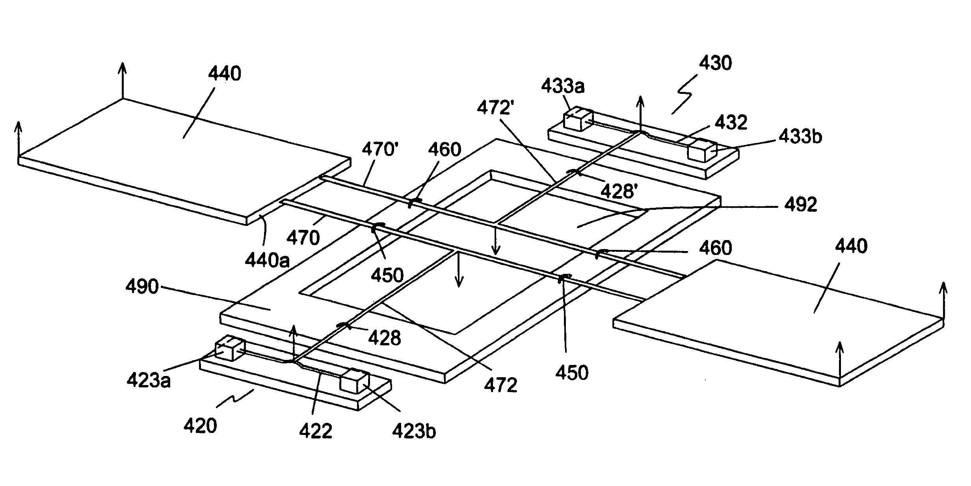
About Dr. Reuel

Slide 5
About Adam
PhD Student @ ISU (Reuel Group)
Grew up in New Hampshire
Sports fanatic (NFL, MLB, NBA)
Zero programming before his first ChE programming class
Notes:
w/ his wife Drew in front of Nebo and fenway park

Slide 6
Your turn…
INTRODUCE yourself to your team mates
Name.
What you did this summer.
Your true feelings about Matlab.
Then come up with a NAME FOR YOUR STARTUP. Present your startup to the class.

Slide 7
Analogy: Toolbox
Differentials
Systems of equations
Curve fitting

Slide 8
My history with programming and Matlab
<HTML>

Slide 9
What if my employer does not offer Matlab?
= $1000 to $3000
= $0
= $0

Slide 10
Who has structured programming experience?
Want to go bowling?
Busy. Maybe L8R?
Yes. When?
[Criteria?]
10:00PM @ Perfect Games. Wing night.
Sorry. 310 Exam tomorrow
[Criteria?]
C U L8R

Slide 11
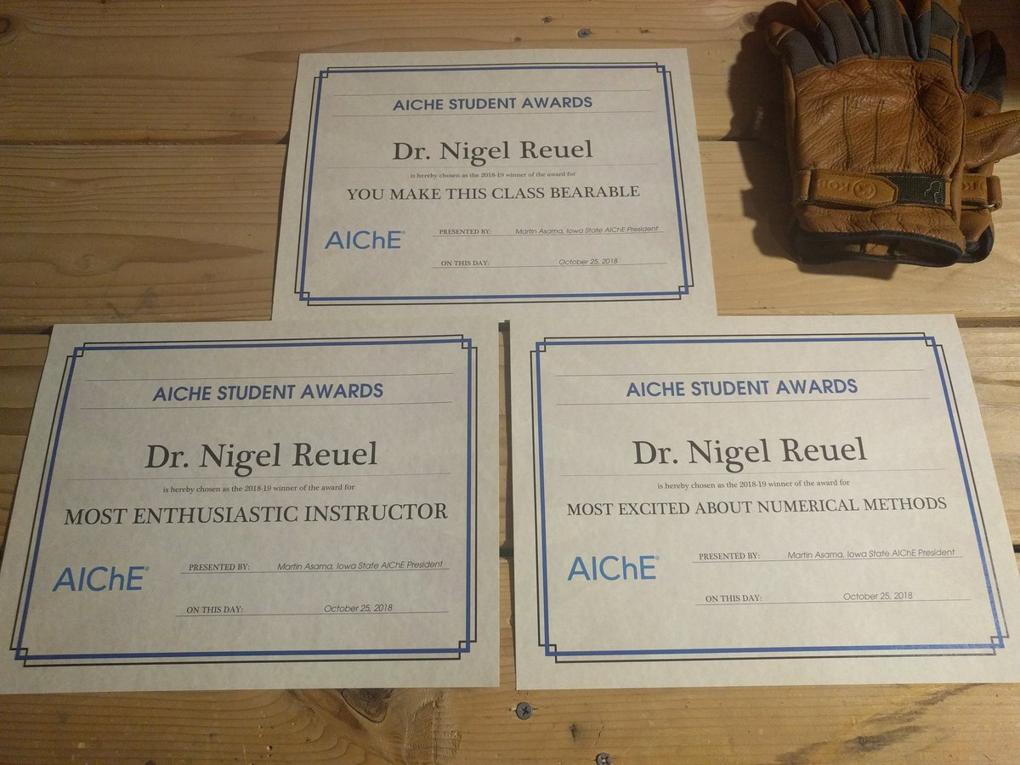
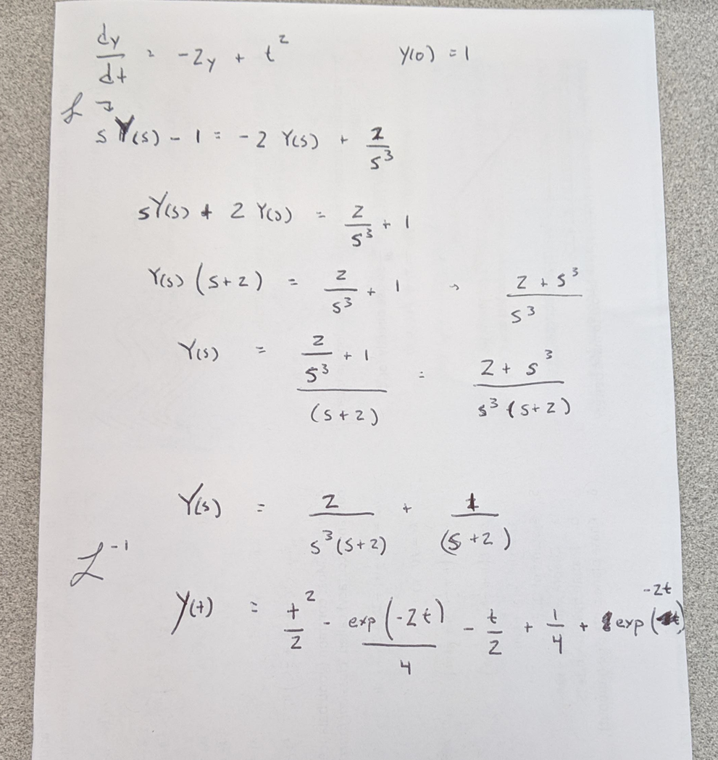
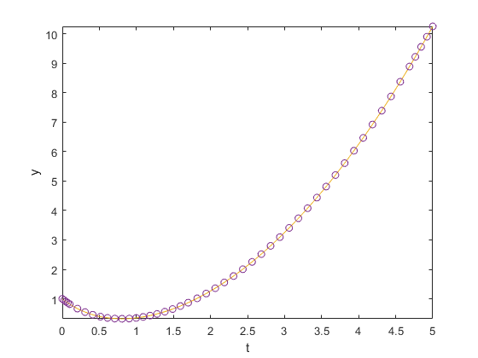
What is a numerical method?
A tool to give approximate answers to problems where the exact solution may be difficult to obtain. Frequently uses iterative methods to converge near the exact solution.
Example:
$\frac{dy}{dt}=−2y+t^{2}$ where $y\left(0\right)=1$

Slide 12
Syllabus Overview
Course Website: reuelgroup.org
http://www.reuelgroup.org/numerical-methods-che-310.html

Slide 13
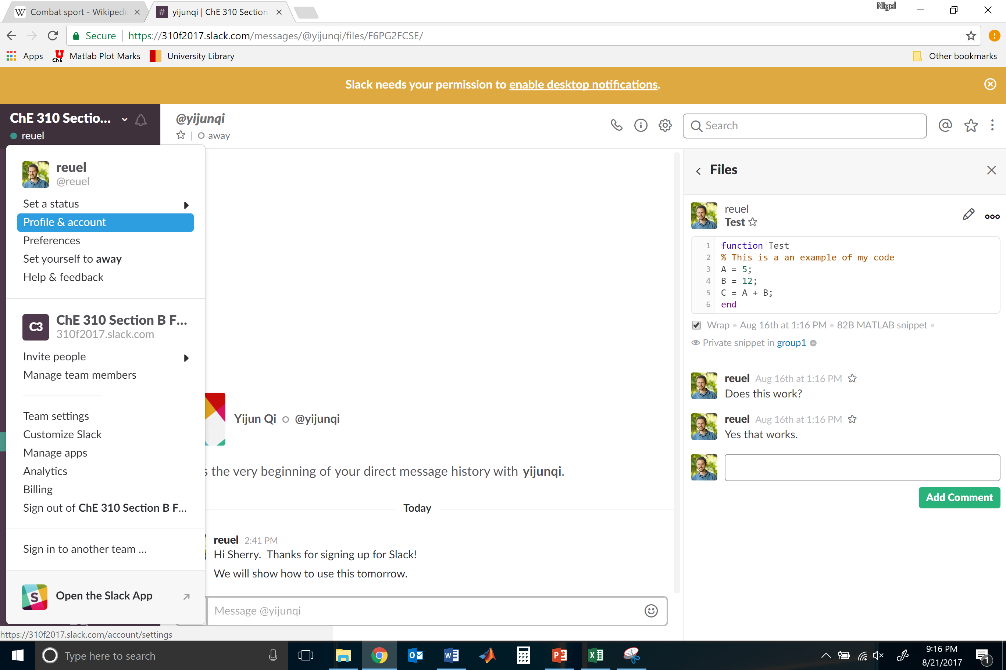
Join by clicking here
Collaboration Tool
https://www.youtube.com/watch?v=9RJZMSsH7-g
Edit profile. Add name and picture.

Slide 14
Unit 1 – Matlab boot camp and basic data manipulation

Slide 15
Unit 2 – Optimization, Curve Fitting, and Systems of Equations

Slide 16
Unit 3 – Designed Experiments and Calculus

Slide 17
The Project
10.1.19 – Memo to boss describing topic(s) of interest and a few (at least 3) possible numerical problems to solve. Cite sources (popular press is fine, journals are good, but interviews with actual industry is best). What data will you use? [2% grade]
11.12.19 – Two Page Project Proposal – Outline problem that your team will tackle and how the work will be divided among your company. What are the responsibilities of each team member? What is the deliverable? Show that you have access to data necessary for this problem. [3% grade]
12.10.19 – Eight-minute presentation and demo of your product to the class. What was the problem? How did you develop a solution? What is the result? [5% grade]

Slide 18
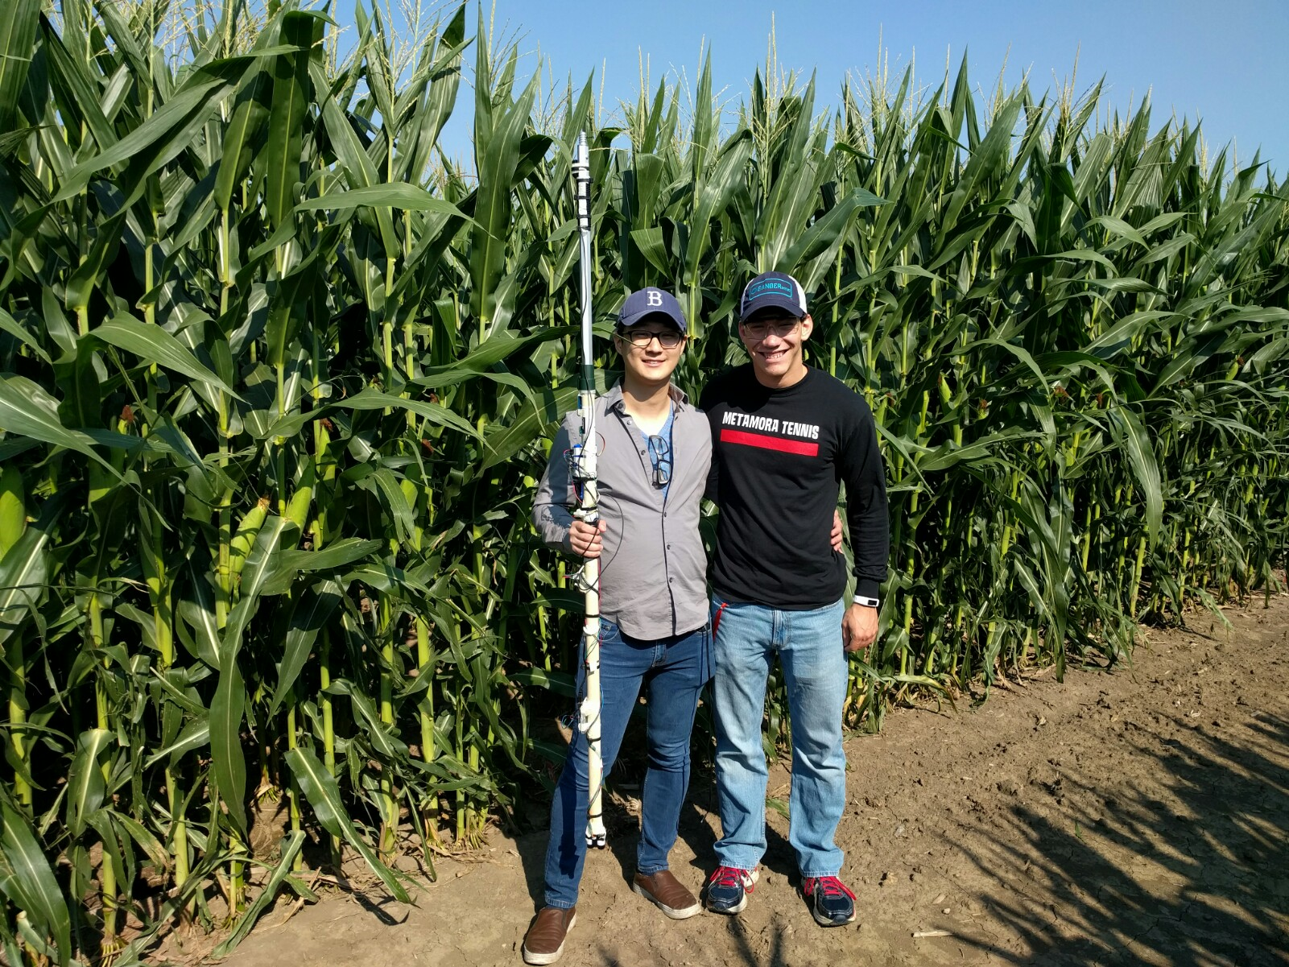
Example
Pioneer requires height measurements of their experimental corn stalks. You have designed a measurement system that automates this data collection. The result is a massive matrix of time, location, height, and vertical alignment:
Your task. Design a program that imports this data, identifies the plants, plots their location on a map, and produces an output of height measurements with standard deviations.

Slide 19
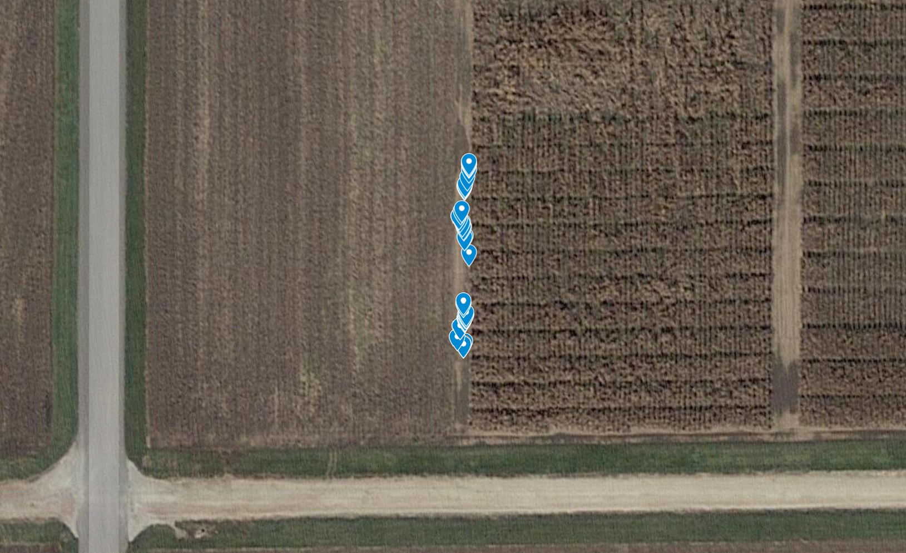
Goal 1: Have fun.
Goal 2: Make it real.
Goal 3: Get stuck, become unstuck. Iterate. Work as group via Slack and in office hours.

Slide 20
