Slide 1
Class 17
Basic Linear Regression

Slide 2
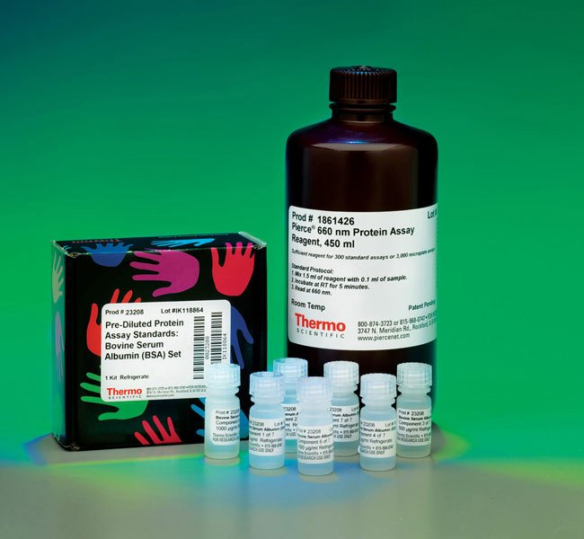
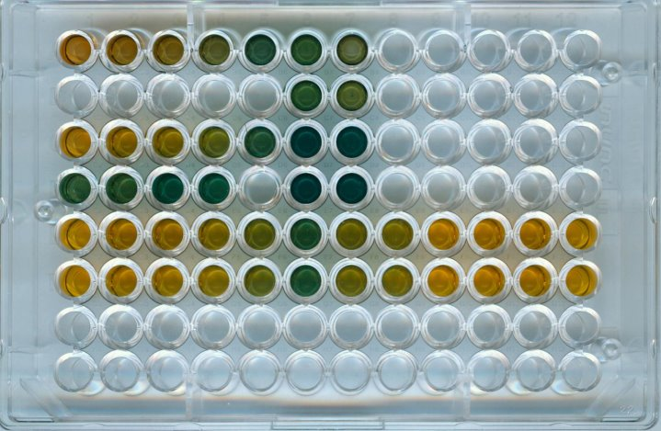
Real Example
Standards
ug/mL
125
250
500
750
1000
1500
2000
Notes:
Show on your white board what the plot looks like…that you are trying to fit a line…

Slide 3
