Slide 1
Luke Roling Slides
[Class 20 – Design of Experiments LAB]

Slide 2
How to make a paper helicopter
Each sheet you’ve been given has 4 templates. Cut out one template.

Slide 3
How to make a paper helicopter
Measure and cut a certain distance down the dotted line. This is the rotor length.
Rotor Length

Slide 4
How to make a paper helicopter
Measure 2 cm from the rotor cut. This is the body length, and is FIXED for this design. (Assume we need to transport passengers in this part of the helicopter ☺ )
Rotor Length
Body Length
2 cm

Slide 5
How to make a paper helicopter
Measure a certain distance across the center of the helicopter, at the base of the body. This is the leg width.
Rotor Length
Body Length
2 cm
Leg Width

Slide 6
How to make a paper helicopter
Cut on both sides of the body base to the marked leg width.
Rotor Length
Body Length
2 cm
Leg Width

Slide 7
How to make a paper helicopter
Fold inward at the dashed lines.
Rotor Length
Body Length
2 cm
Leg Width

Slide 8
How to make a paper helicopter
Mark a certain distance along the leg. This is the leg length.
Rotor Length
Body Length
2 cm
Leg Width
Leg Length

Slide 9
How to make a paper helicopter
Fold upward at the dashed line.
Rotor Length
Body Length
2 cm
Leg Width
Leg Length

Slide 10
How to make a paper helicopter
Fold the rotors in opposite directions at the dashed lines.
Rotor Length
Body Length
2 cm
Leg Width
Leg Length

Slide 11
Design objective
Your goal is to make a paper helicopter with maximum flight time.
3 manipulated factors: Rotor Length, Leg Width, Leg Length
Constraints:
You must use the full template provided. No trimming, adding extra paper, etc. Body length must be 2 cm. No modifying the prescribed design aside from the 3 factors above.
No using extra paper for additional trials! You have 32 templates available. This includes all your experimental runs, your final optimal design (for competition), and any mistakes that you might make along the way.

Slide 12
Design suggestions
Keep in mind the principles we discussed last class:
What are feasible ranges for each of the three factors? Use this to determine your design runs.
What response surface model do you think would work best? (BB, CCC, CCI, CCF)
Repetition of experiments helps understand noise.
This refers to more than just dropping the same helicopter multiple times. Constructing the “same” helicopter multiple times might be useful, to account for cutting/other design variations.
Remember to randomize your sampling order.
It’s a good idea to test your optimal design.

Slide 13
Procedural suggestions
Assign roles within your team. Possibilities: recorder, dropper, timer, helicopter assembler(s), or others.
How will you drop from a consistent height?
Although you’ll attempt to construct these according to your design strategy, measuring your helicopters after they are built and recording the actual dimensions will give you improved model accuracy.

Slide 14
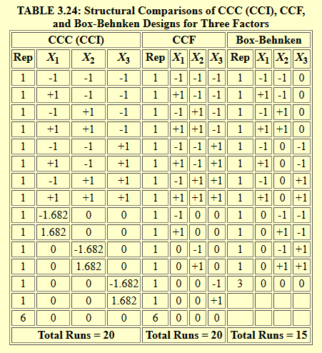
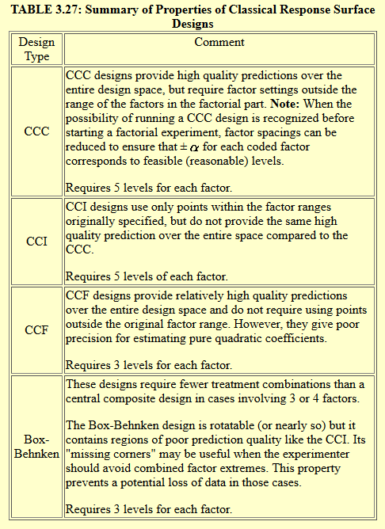
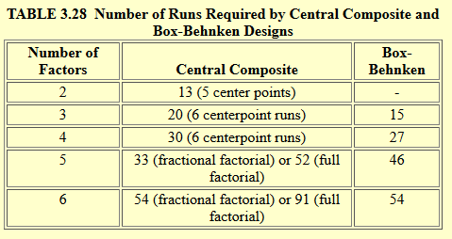
Response Surface Designs (NIST)
Note: MATLAB adds 4 center point runs for 3-factor Central Composite design, so it provides 24 total runs.
https://www.itl.nist.gov/div898/handbook/pri/section3/pri3363.htm

