Slide 1
FALL 2019 DEMO DAY!
Term Project Demonstrations
12.10.2019

Slide 2
A few QUICK reminders
PSET 12 key posted (not graded!)
Final exam practice materials are posted
Last class is this Thursday – Python overview + some review
Office hours this week are as USUAL
Friday help – noon to 1 (3041 Sweeney)
Office hours next week – 2:30 to 4 Mon and Tues in 2126 Sweeney
Class feedback – survey is open! If you have time also consider RMP (I take your feedback to improve the course, so thanks!)
End of year can be STRESSFUL, if you are overwhelmed please talk to me or other resources (friends, counseling 515-294-5056)

Slide 3
Today
6 min to talk
~1 min for questions
Everyone needs to fill out the peer feedback sheet (see link on SLACK)

Slide 4
[1] Latmab-x
Charles-analysis, Alissa-data, divyesh-code
Emma-optimization, Nathan-tester

Slide 5
The Problem
Apartment shopping can be a large hassle
Distance can play a big factor in apartment price
How to cut out the noise from the data and get to the actual price, and how good of a deal the apartment is?
Our Process cuts the noise out, and gets to the info that really matters, the value of the apartment in relation to its distance

Slide 6
The Algorithm
Multiple linear regression method, uses walk time as a variable
Includes some calculations based off amenities
Reads all data from an excel document
Displays outputs both in graphical and text form

Slide 7
Demonstration

Slide 8
Improvements
Better system to deal with amenities
Utilize more data to get a better look at prices
Increase the usable range of the Algorithm
Could also include Cyride travel data to increase the usable range of the algorithm

Slide 9

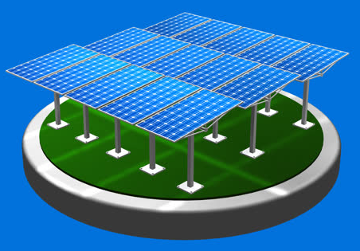
[2] TEAM
DOWNSTREAM PETROLEUM
Optimal placement of Solar Panels in Iowa
(Expecto Petroleum)
By:
ERIN DONALDSON - DATA COMPILER/CODER
LANCE PARISH - DATA COMPILER/coder
WOON TIAN LI - DATA COMPILER/Powerpoint
SARAH FANGROW - DATA COMPILER/coder
MICHAEL MOMCHEV - DATA COMPILER/CODER

Slide 10
THE PROBLEM
Haven’t you ever wondered where the optimal place to put a solar panel field in Iowa is?
So have we! But why is it important?
The international push to find cleaner and better energy sources!
This is a worldwide issue!
So many variables to account for…
Don’t you want to be a part of the future?

Slide 11
DESCRIPTION OF ALGORITHM
Entered latitude and longitude
Read in data
Int2string and mean
For loops
Optimized data with an equation
If/else/elseif statements

Slide 12
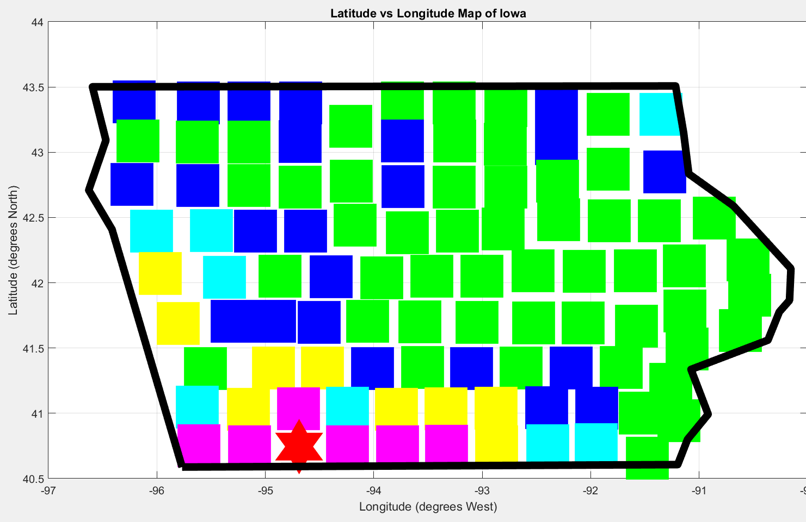
With our algorithm we can change the importance of parameters to decide which area works best.
Example: We can decide that we want sun light hours per day to be the most important.
MATLAB DEMO

Slide 13
IMPROVEMENTS FOR NEXT TIME
Input the border points for counties to make a more seamless graph
Choose more/different variables to account for
Find a better way to graph (meshgrid, surface plot, contour, etc…)
Expand process to a different/larger area

Slide 14
[3] SPAM
Data Collectors:
Sean Gallagher and Ben Habel
Code Creators:
Anders Glad and Graham Owen
PowerPoint Creator:
Karl Kaale

Slide 15
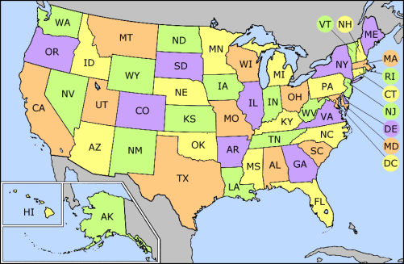

Motivation
Optimal place to live by comparing the 50 largest cities in the US
  Help users decide where to live and work
  Issue that many will face at some point in time
  Can aid in a decision between job offers

Slide 16
Algorithm Basics
Collected and read population, crime rate, and unemployment data into MATLAB
  Working with variables that represent tables offered most difficulty in the algorithm
Differentiated each data set utilizing loops and evaluated them at the final year
  Yielding change in population, crime, and the unemployment rate and current values of crime and unemployment
User inputs a number from 0 (no importance) to 10 (most important) based on how much they value each factor
Created a utility function to evaluate a score for each city
Sorts cities from greatest to least match based on score

Slide 17
Code Demonstration

Slide 18
Analysis of Results
City
__________________
'Honolulu'
'San Francisco'
'Minneapolis'
'Nashville'
'San Jose'
'Austin'
'Virginia Beach'
'Boston'
'Omaha'
'San Diego'
'Denver'
'Oklahoma City'
'Seattle'
'San Antonio'
'Oakland'
'Indianapolis'
'Kansas City'
'Jacksonville'
'Raleigh'
'Tulsa'
'Portland'
'Fort Worth'
'Dallas'
'Miami'
'Charlotte'
'Sacramento'
'Colorado Springs'
'Wichita'
'Columbus'
'Milwaukee'
'Mesa'
'Louisville'
'New York'
'El Paso'
'Chicago'
'Houston'
'Phoenix'
'Atlanta'
'Albuquerque'
'Memphis'
'Tucson'
'Los Angeles'
'Long Beach'
'Las Vegas'
'Philadelphia'
'Washington'
'Baltimore'
'Fresno'
'Cleveland'
'Detroit'

Slide 19
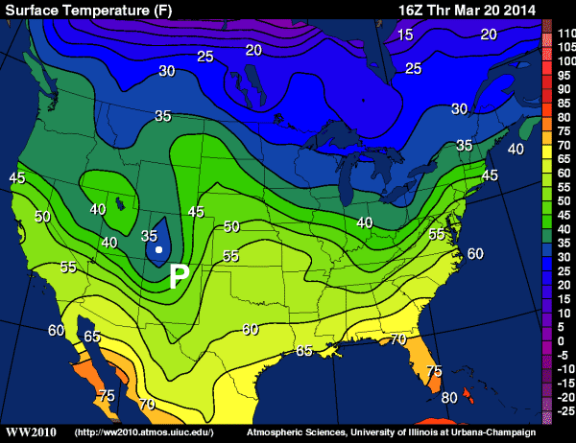
Improvements
Add more cities, users may want to live in a smaller city
  Add a factor of population size
Implement other data such as weather, median income, education system, night life and job market breakdown
Create a contour plot of the US based on each cities ranking

Slide 20

[4] MACER
Aurelien: Code
Christopher: Obtain data/Graphs/Visuals
Rachel: Obtain data/code
Ellery: Optimize
Mukunth: Code

Slide 21

Motivation
Allows for analytical research to be done
Provides a way for fair and reasonable projections involving the USPS
Make predictions for when physical mail theoretically would become obsolete

Slide 22

Algorithm
Manually inputted data from https://facts.usps.com/table-facts/ into Excel
Takes inputs from user as strings
Reads data from Excel, and uses linear regression models to fit data and interpolate or extrapolate

Slide 23
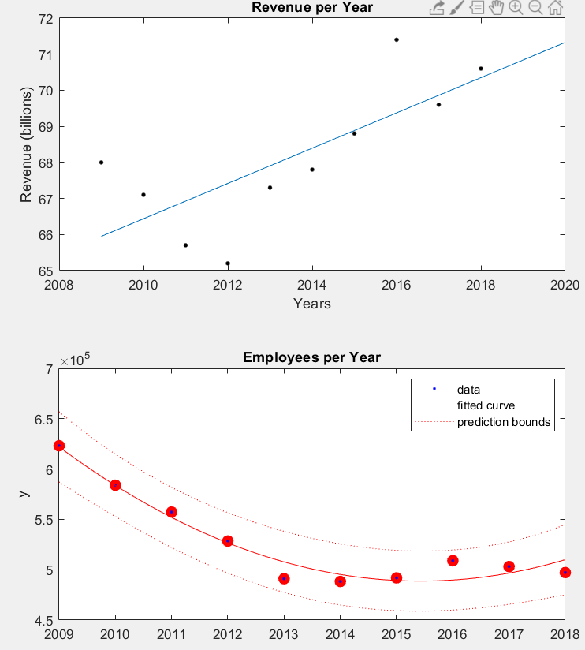
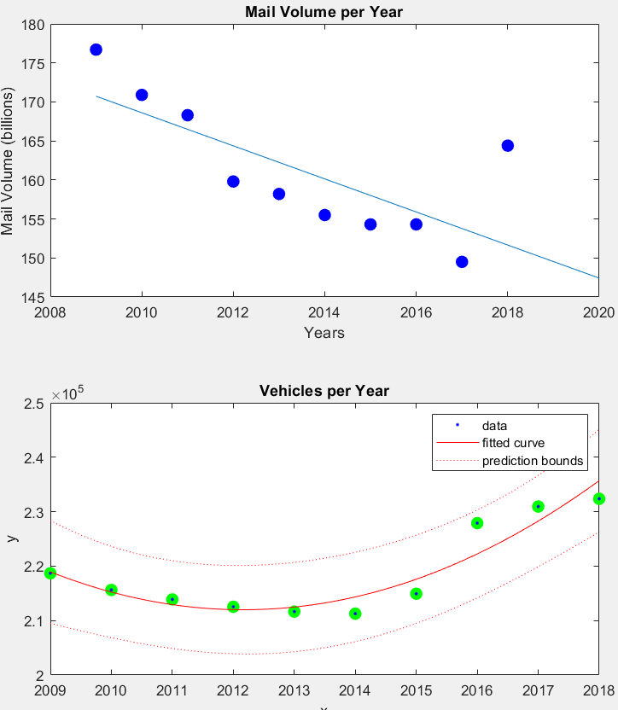
Showcase algorithm
Cubic fit trend lines were used for two of our graphs, i.e. Employees, and Vehicles
A linear fit was used for Revenue and Mail Volume

Slide 24
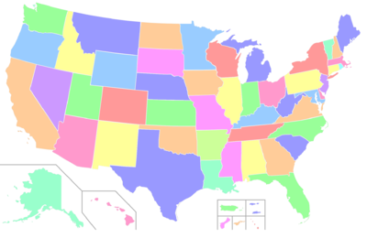
Improvements
Input more data, potentially expanding into counties
Including population change via census data
Include entirety of US and all territories that the USPS encompasses
Find better fits for more accurate projections

Slide 25
by Zero Point Energy
[5] Optimization of Solar Power Production on Mars
James Trettin – Code
Jake Smith – Code
Zack Lynch – Data Formatting
Hassam Shaikh – Data Collection
Nia Johnson – Various Assistance
Marshall Penn - Presentation

Slide 26
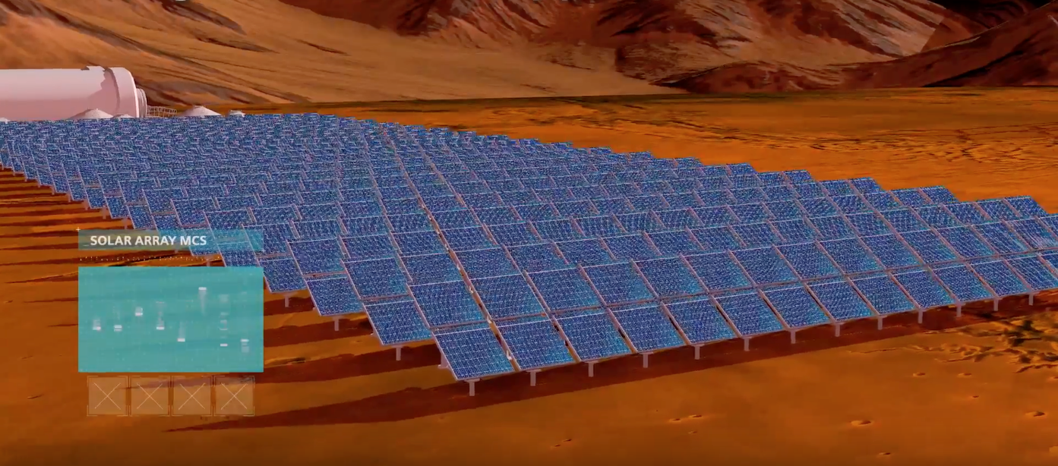
Motivation
Solar Panel Optimization
  Will be able to stay on Mars for longer periods of time
  Want solar collection to be as efficient as possible
  Solar power is a free, limitless source of energy
https://www.google.com/url?sa=i&source=images&cd=&cad=rja&uact=8&ved=2ahUKEwiL-9jBvanmAhVCjp4KHWyhDnQQjRx6BAgBEAQ&url=https%3A%2F%2Fwww.inverse.com%2Farticle%2F35605-human-mars-colonies-civilizations-energy-power&psig=AOvVaw1tF1Kr4KaFKlyZMjgXxyL_&ust=1576012266894334

Slide 27
Collecting Data
Areocentric longitude (Ls)(NASA):
  https://nssdc.gsfc.nasa.gov/nmc/dataset/display.action?id=PSPA-00526
  https://pds-atmospheres.nmsu.edu/PDS/data/vl_1001/
Elevation (WUSTL via NASA):
  https://pds-geosciences.wustl.edu/missions/mgs/megdr.html
Misc (NASA):
  https://ntrs.nasa.gov/archive/nasa/casi.ntrs.nasa.gov/19890018252.pdf

Slide 28
Our Algorithm
Functions used
  Interp2
    Found optimal places for colonies/solar plants
  Fminbnd
    Optimizes angle for solar panels over the Martian year
  Curve Fitting
    Used to find data, and visualize trends
  Contour Plot
    Used to visualize the topography of Mars

Slide 29
Code Showcase

Slide 30
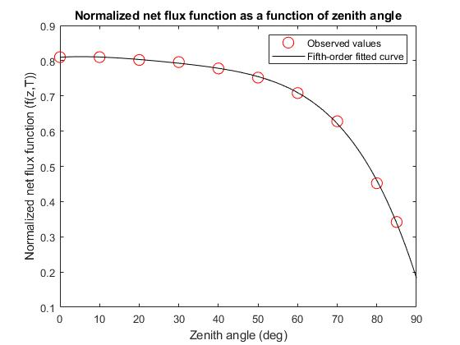

Slide 31
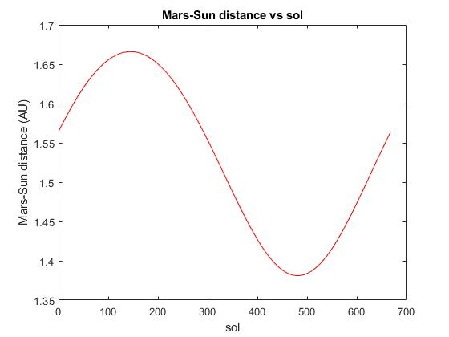

Slide 32
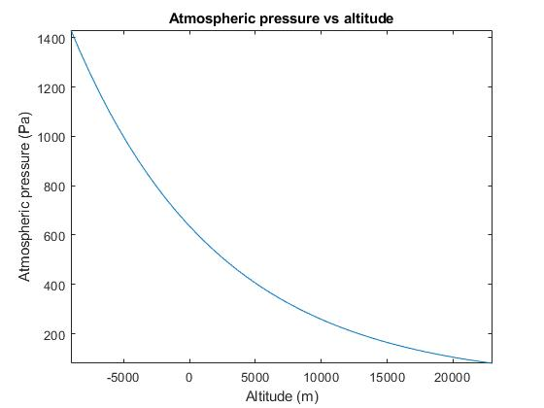
Improvements
Code
  Not very precise data on Mars landscape
Mars Landscape
  Dust Storms would hamper efficiency of solar panels
Atmospheric Pressure
  Slightly alters the solar collection with varying elevation

Slide 33
[6] S.W.H (Upstream)
By:
Jackson Lee - Head Coder
Sierra Teeter - Presentation, Co-data collector
William Smith - Co-data collector, Coding
Stephen Majors - Co-data collector, Coding
Qing Leow - Co-data collector, Coding

Slide 34
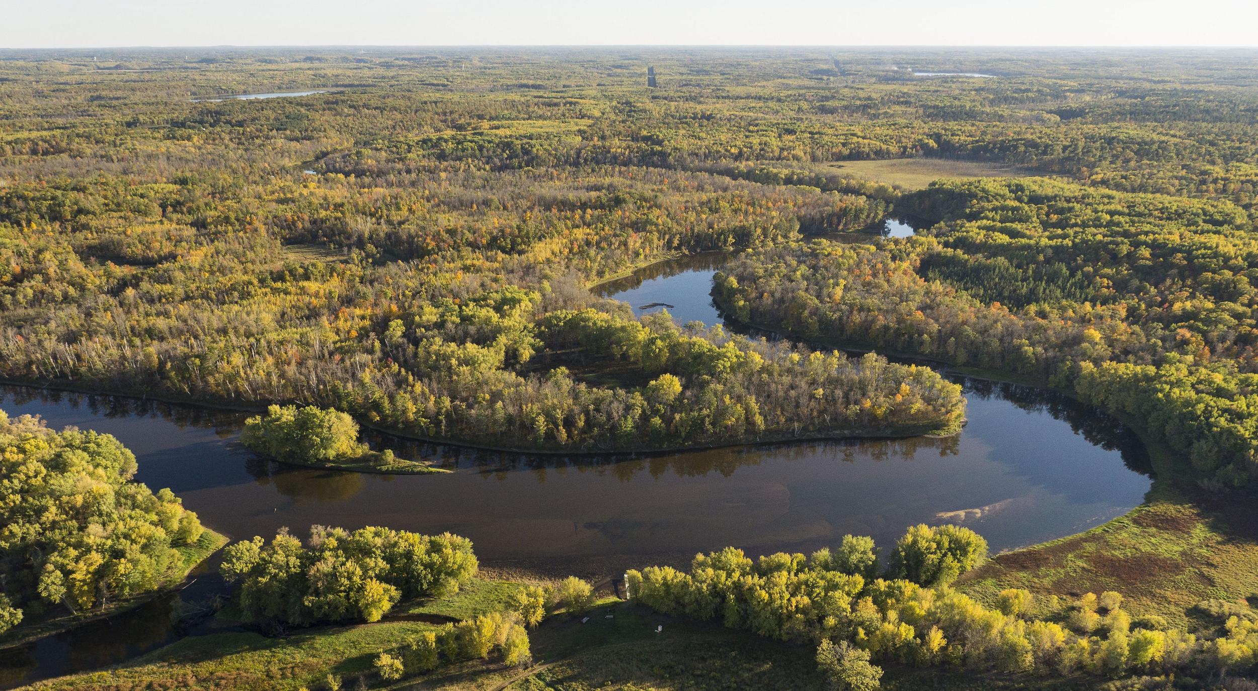
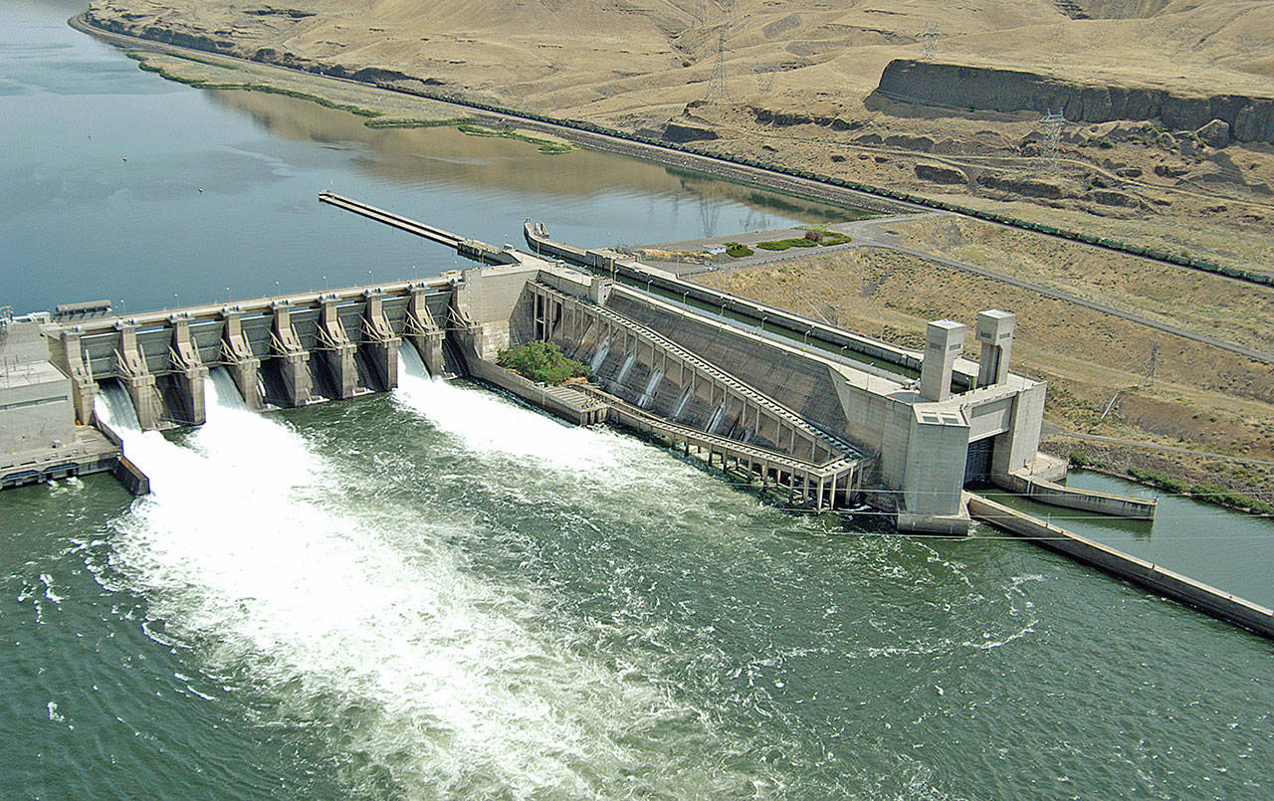
Motivation
Project Dam that River
Produce significant amounts of hydroelectric power.
Locate several, potential locations along the river.
Determine optimal location for quickest return of dam constructions cost.
Create millions of dollars in electricity revenue.
Hydroelectric power is very green, Mississippi river can produce a lot of it

Slide 35
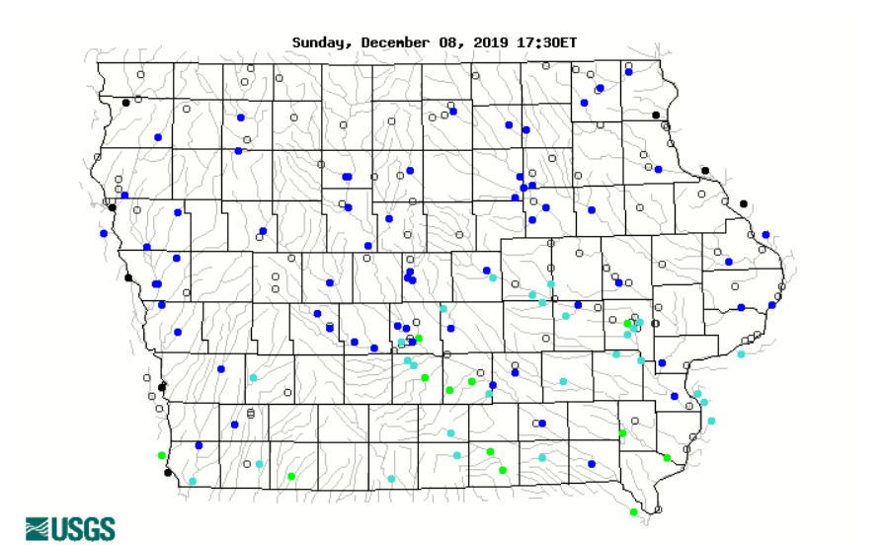
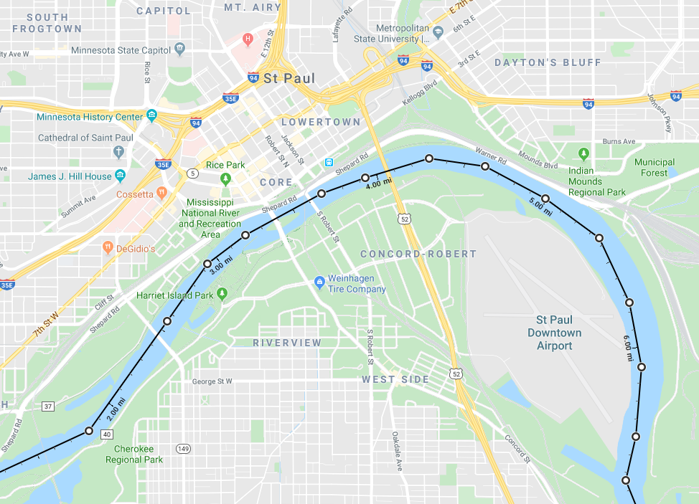
Data Collection
Determined 15 cities located along the Mississippi.
Use interpolation to find other optional locations between chosen 15 cities.
Flow rate data collected from US Geological Survey.
Labor cost data collected from public government information.
Concrete and dam construction costs collected from previous dam construction projects.
Record data in Excel to be read into MATLAB.
No current data for changing width of river along entire length.
  Used distance tools to determine width of river at each chosen location.
No current data for how far cities are located down the river.
  Used distance tools on google maps to roughly estimate distance data.

Slide 36
Our Algorithm
Reads in data from Excel regarding river at 15 cities
Uses kinetic energy balance to determine how much electricity can be made in each spot
Taking into account cost of materials, electricity, and minimum wage, determines which city is the best spot for a dam
Interpolates between each two cities all river data using spline
Runs the same analysis on each interpolated point to find if there is a good spot between the two cities
Presents which spot takes the fewest number of days to break even monetarily

Slide 37
Code Demonstration

Slide 38
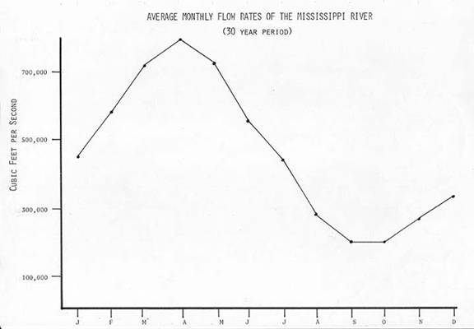
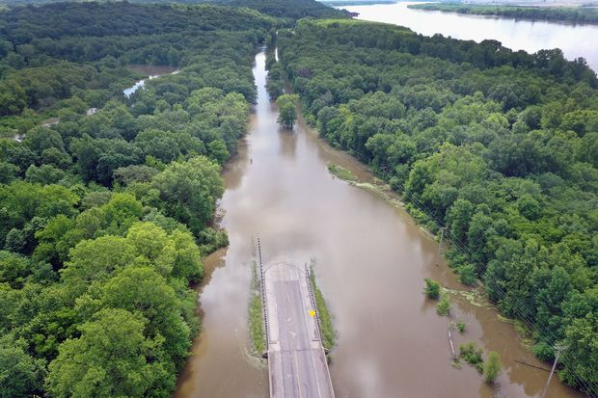
Improvements
Research and locate accurate data for distance of cities along the river and corresponding width.
Determine a yearly average flow rate of the river across different locations.
Account for drastic depth change due to flooding and water level changes.
Determine a way to read data live into an excel sheet to be used for updating data in real time.
Account for the shape of the riverbed.

Slide 39
[7] DELTK Medical
Ellie Condon: Data Collector
Kevin Fan: Team Leader
Daniel Hammer: Coder - Searchable Database
Lauren Jean: Coder - Model Fitting
Tommy Simon: Coder - Searchable Database

Slide 40
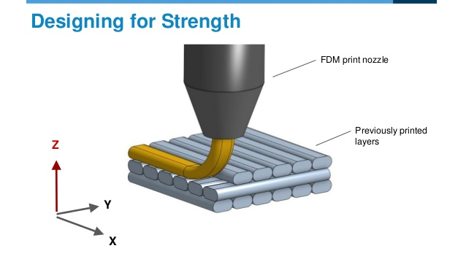
Our Purpose
Utilizing a common material extrusion fabrication method (FDM ) in order to 3D print human bones with various 3D printing parameters.
The Solution
We created a program to generate a list of suitable materials as well as optimal print setting
Why?
Speeds up the process of searching for materials
Allows more types/brands of material to be tested
More precise strength estimation
Low cost prosthetics
https://www.slideshare.net/ShuvomGhose/how-to-3d-print-right-now
Notes:
To start, here is a brief introduction to the parameters that are being tested in this project.
Over here you can see a nozzle here. The nozzle diameter is the extrusion width of the material coming out of the nozzle. The layer height is the height between each layer. And the printing speed is the volumetric flow rate for the material.
Our purpose:
Solution: We know the ultimate tensile stength(Pressure and breaking point) is one of the most important criteria, that’s why we are testing to see if we can optimize this based on those parameters. And thus finding a general optimal setting for 3D printing.
With current manufacturers, they only list their maximus strength based on standard testing but does not provide an estimation in real llife applications.

Slide 41
Our algorithm
Input testing data
Create model fit
Use data to find increase in maximum tensile strength
Apply the percentage increase in maximum tensile strength to current supplier data
Generate a database based on tensile strength input
Model fit function (fitlm)
  Remove terms
Optimization function (feval)
Notes:
Converted pdf data into excel file using OCR Optical Character Recognition.
Created a quadratic linear regression model fit and removed inrelavent terms
Then we find the maximum value ….same as shown

Slide 42
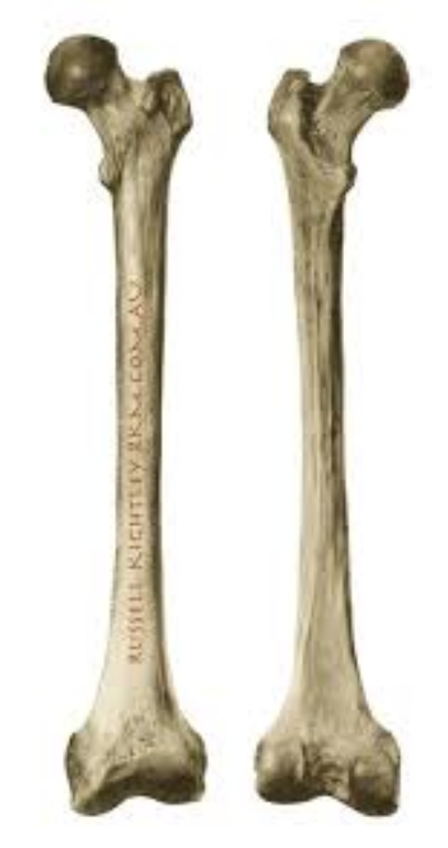
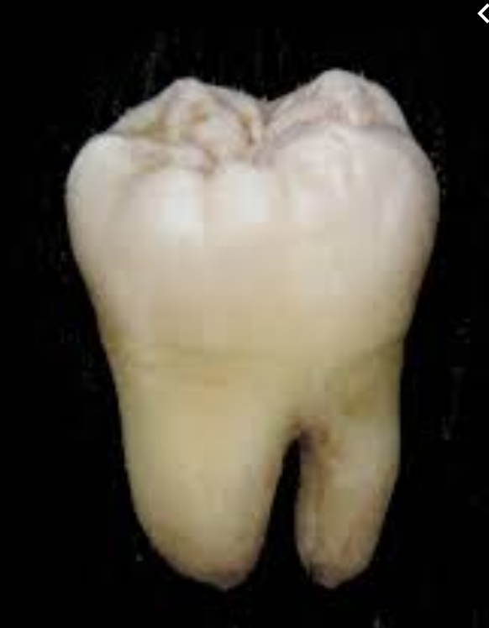

Program Explained & Demo
Femur: 135 +/- 15MPa
Tooth: 42 +/- 7 MPa
Phalanx: 37 +/- 5 MPa

Slide 43
Future Improvements:
Expand the database so that the user can search for other materials besides polymers and additional physical properties such as percentage elongation, young’s modulus, etc.
Assign variables to allow database to account for biocompatibility, not just mechanical properties.
Add an economic component.

Slide 44
Questions?

Slide 45
[8] Drugs4Days
By:
Ansgar Uhrmacher: Head Coder
Ciara McNeley: Code Advisor
Grant Samson: Map Maker
Samantha McCulley: Data Collector
Tahsin Islam: Data Collector
Notes:
Sami

Slide 46
Motivation
Pharmacy Locator in Iowa
  Determines closest pharmacy
  Optimizes travel time for customer
  Can be applied for distribution purposes
  Does not require internet access
Notes:
Ciara

Slide 47
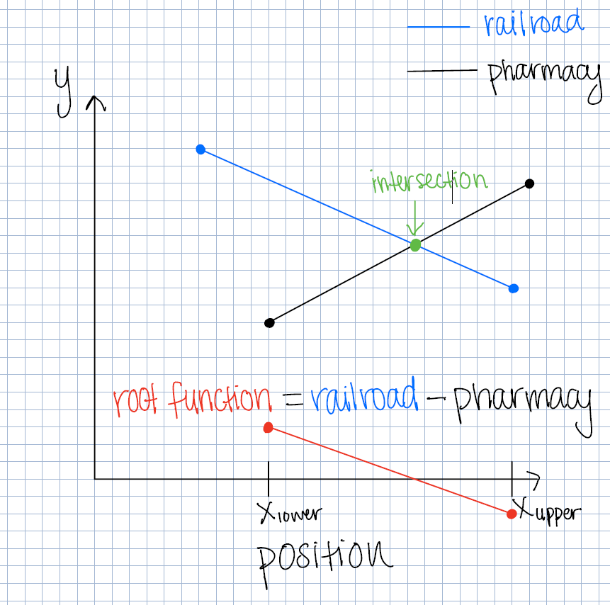
Algorithm
Import data from excel
Create linear functions for railroads and pharmacies
Root-finding (inspired by bracketed methods)
Optimize time
Notes:
Ansgar

Slide 48
Showcase
Notes:
Tahsin
Any coordinate
2 coordinates between 41 and 43, -91 and -96
41.0974, -93.7268 (cross railroad)

Slide 49
Improvements
Input and output addresses instead of coordinates to make user friendly
Provide specific travel route with directions
Include information of pharmacy (i.e. hours of operation)
Use smaller search area to make optimization more efficient
Notes:
Grant

Slide 50
[9] AgStags Corn Growth Operation Initiative
Ben Eide
- Interpret coding results
Chris Adler
- Code, Graphing
David Boorom
- Revise/optimize code
Isaiah Pearson
- Coding and Data Analysis

Slide 51
Motivation
Agstags Mission:
Using data from 2009 to present we estimated the amount of crops harvested in bushels per acre

Slide 52
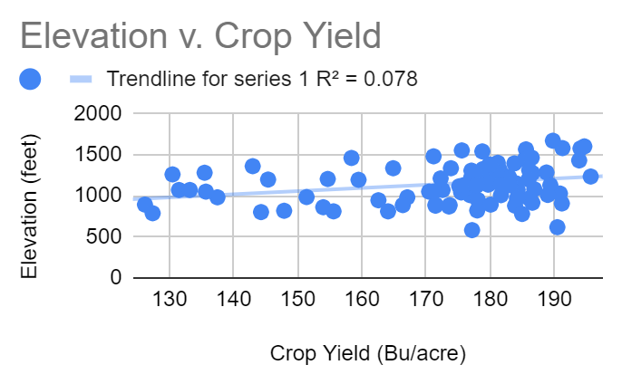
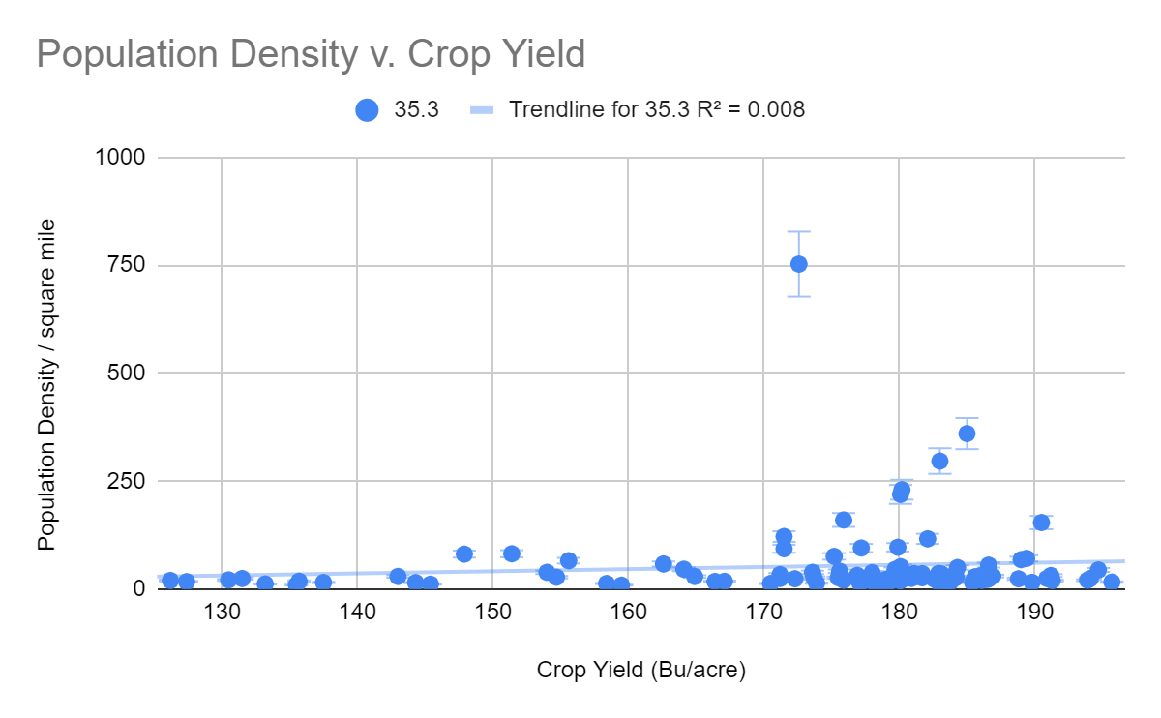
Correlation
http://www.usa.com/rank/iowa-state--population-density--county-rank.htm
A couple outliers: Polk county (Des Moines)...
Crop growth holds little to no correlation with elevation or population density. The main contributing factor to growth is the amount of rainfall (measured in inches per year)

Slide 53
Obtaining Data and Our Algorithm
***Population Density: http://www.usa.com/rank/iowa-state--population-density--county-rank.htm
Corn Yield: https://www.extension.iastate.edu/agdm/crops/pdf/a1-12.pdf
Rainfall: https://mesonet.agron.iastate.edu/ASOS/reports/mon_prec.php?year=2009
Using the provided data links we exported it to excel at first then imported the data in Matlab.
We then used the data in Matlab to create a function that is able to give a predicted crop yield given a user inputted amount of rain.

Slide 54
Code Showcase

Slide 55
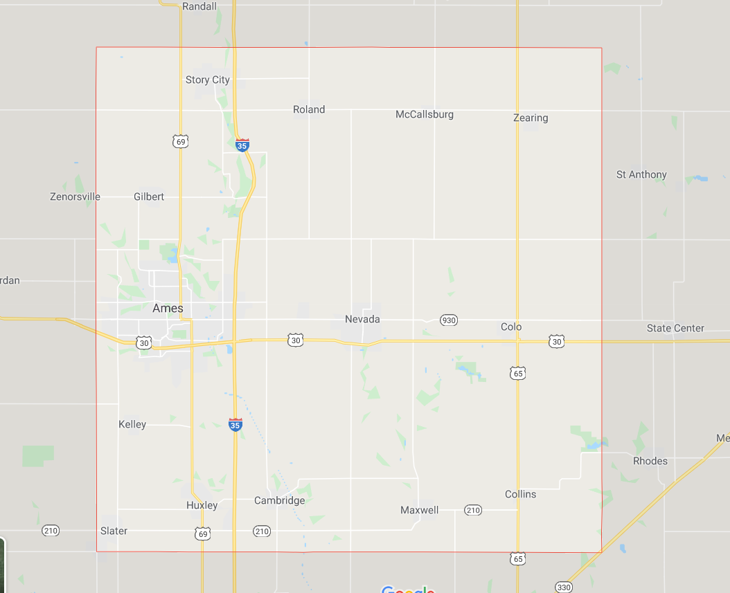

Slide 56
Improvements
Having more data to work with, i.e. more years, more places, soil quality
Input more factors to help more accurately predict the amount of bushels of corn

Slide 57
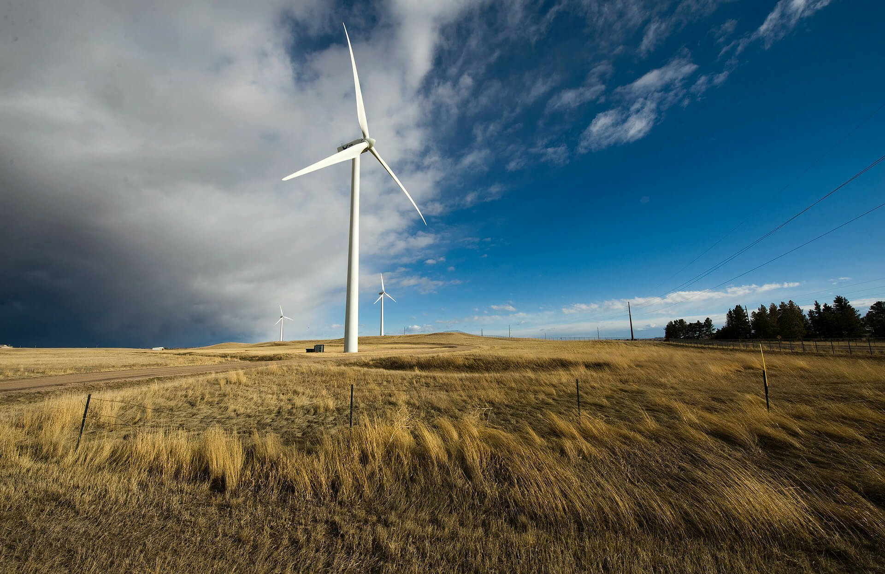

Benjamin Matlock - Code/CEO
Michael Garcia - Obtain and Prepare Data/President
Alexander Fiscu - Finalize and Present Data/Vice President
Leroy Lee - Obtain and Prepare Data/Secretary
Jian Liang - Code/Intern
[10]

Slide 58
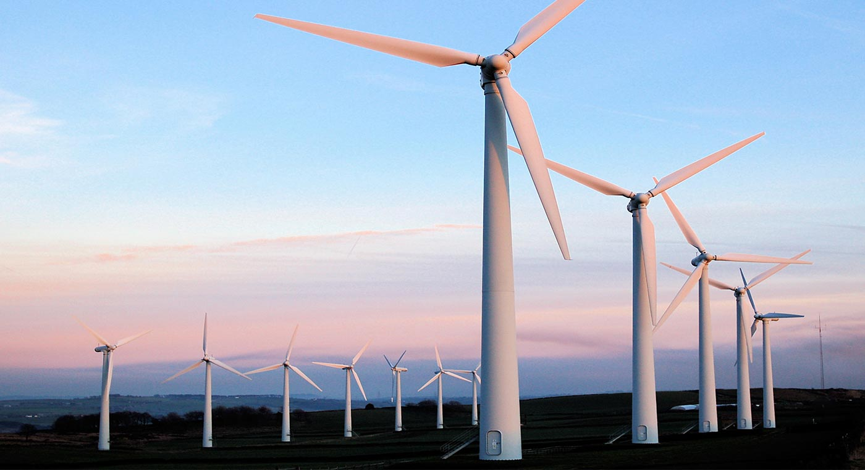
Motivation
Wind Turbines are a great source of renewable energy, however, residents living close to wind turbines often complain that they are unsightly and noisy. To mitigate these issues, our group has optimized wind turbine placement to maximize wind speed in order to maximize energy production and to minimize population to minimize the nuisance to nearby residence. In addition, increased wind turbines will satiate increasing demands for energy with the increases in population as well as energy requirements due to technological advancement. Our code brings us closer to decreasing our reliance on fossil fuels as we moving closer to making self sustaining renewable energy sources the norm.

Slide 59
Description of MatLab Algorithms
Our code:
Plots the existing 5027 wind turbines in Iowa on the map using red cross markers. The code weights average wind speed and population data and optimizes location to minimize population while maximizing wind speed.

Slide 60
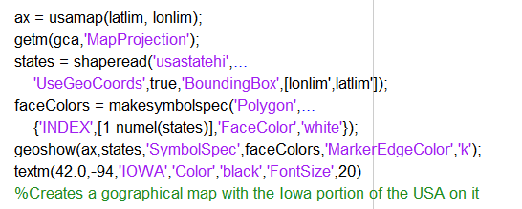
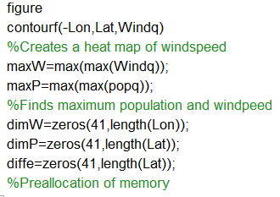
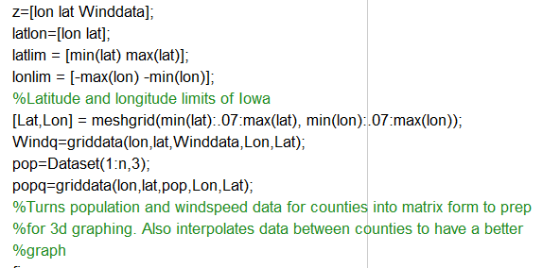
Showcase

Slide 61
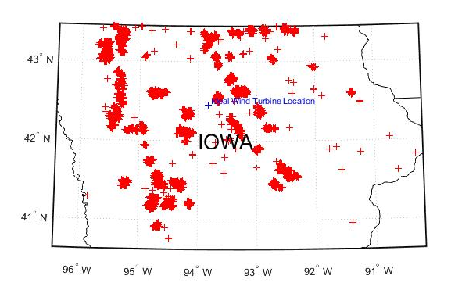
Showcase: Optimal Wind Farm Location

Slide 62
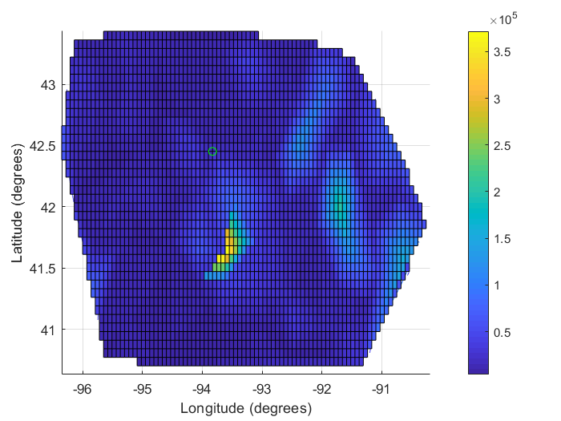
Showcase: Population Heatmap

Slide 63
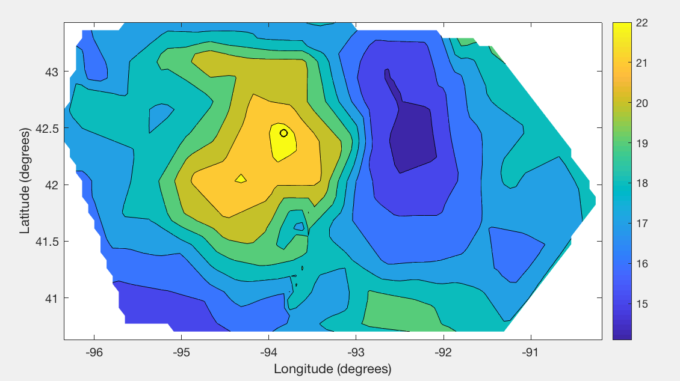
Showcase: Average Wind Speeds (MPH)
Average Wind Speeds (MPH)

Slide 64
Future Improvements
In future versions of the algorithm, we hope to increase computation speeds to make the code more efficient as well as making it easier to apply to different data sets across the world. We also hope to implicate better optimization criteria to best suit a broad range of geographical and social needs. Finally, we hope account for pre built structures and geographical features which could prevent wind turbine erection.

Slide 65
Citations
Froese, Michelle. “MidAmerican Energy Announces Two New Iowa Wind Farm Projects.” Windpower Engineering & Development, 2 May 2018, www.windpowerengineering.com/midamerican-energy-announces-two-new-iowa-wind-farms-as-part-of-wind-xi-project/.
https://www.legis.iowa.gov/docs/publications/IET/615751.pdf
https://www.iaenvironment.org/webres/File/Iowa%20Wind%20Energy%20Fact%20Sheet.pdf
https://www.iaenvironment.org/webres/File/News%20%26%20Resources/Publications/Executive-Summary-Iowa-Wind-Potential.pdf
www.studentenergy.org/topics/renewable-energy.
https://cleangridalliance.org/our-work/projects?gclid=Cj0KCQjw6eTtBRDdARIsANZWjYYVkxnkgrJGPwK8QwTdEHhRjOBobryiDCmTh6xwhlwiV5YNyaEsyA4aAkv-EALw_wcB
https://www.mathworks.com/matlabcentral/answers/402858-how-to-plot-latitude-and-longitude-data-on-map

