Slide 1
Lecture 21 Visuals
Integration Part I
Chapra chp. 19

Slide 2
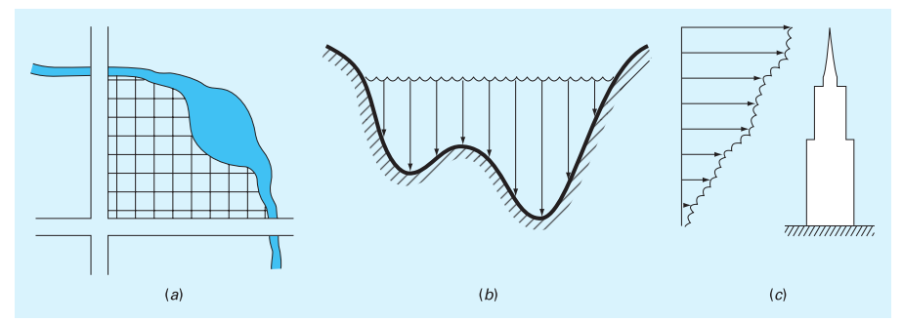
Integration and Engineering

Slide 3
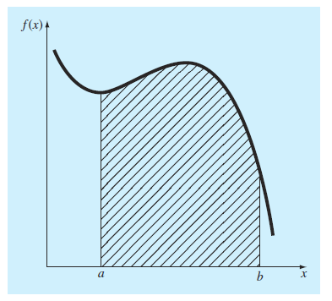
Integration: infinite sum

Slide 4
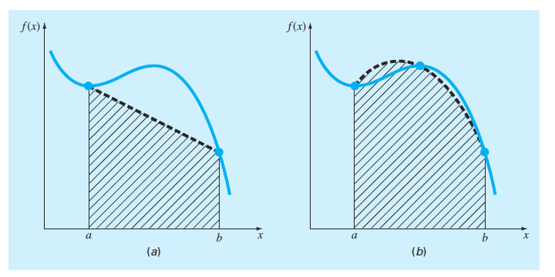
Newton Cotes Approximations

Slide 5
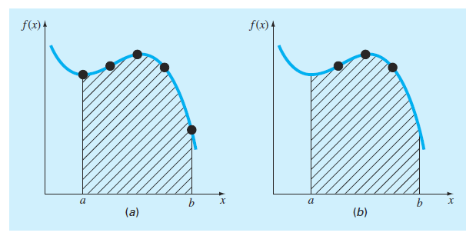
Closed vs. Open Form
Notes:
Open – integration range extends beyond the limits of your data. We focus on closed!

Slide 6
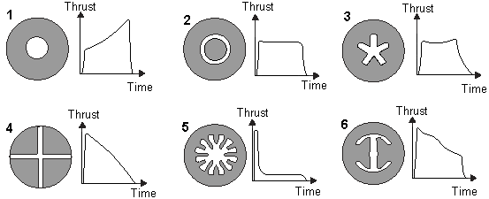
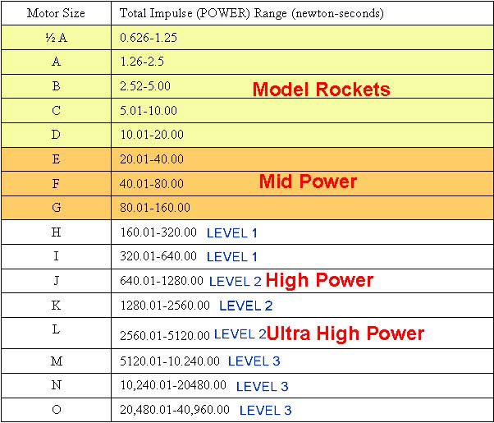
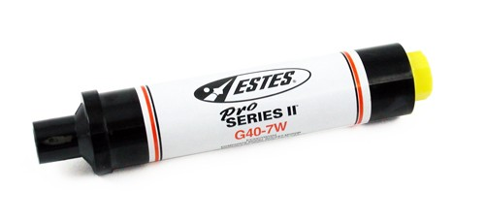
Motivating Problem – Impulse of Rocket Engines
https://goo.gl/images/mGMp7O
$27+$35S/H
Solution – build your own! https://youtu.be/IohvihUgYk8

Slide 7
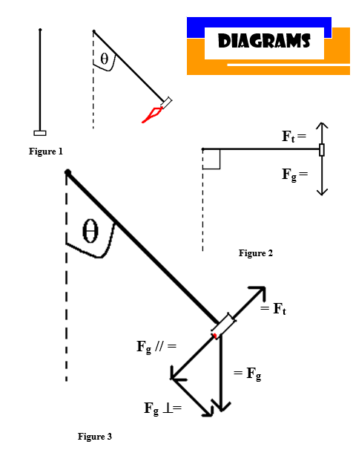
Example – Rocket Data
 | Rocket 10
Weight at 90 degrees (N) = | 33.5
Starting time (s) = | 2.22
Real Time (Seconds) | Angle Measurement |  | Time | Thrust
2.22 | 0 |  | 0 | 0.00
4.47 | 1 |  | 2.25 | 0.58
6.35 | 5 |  | 4.13 | 2.92
6.76 | 10 |  | 4.54 | 5.82
6.89 | 13 |  | 4.67 | 7.53
7.02 | 20 |  | 4.8 | 11.46
7.09 | 23 |  | 4.87 | 13.09
7.19 | 30 |  | 4.97 | 16.75
7.29 | 36 |  | 5.07 | 19.69
7.36 | 40 |  | 5.14 | 21.53
7.46 | 46 |  | 5.24 | 24.09
7.53 | 50 |  | 5.31 | 25.66
7.66 | 55 |  | 5.44 | 27.44
7.8 | 60 |  | 5.58 | 29.01
8.03 | 64 |  | 5.81 | 30.11
10.76 | 25 |  | 8.54 | 14.16
14.79 | 3 |  | 12.57 | 1.75
20 | 0 |  | 17.78 | 0.00
=sin(θ*3.141/180)*33.5

Slide 8
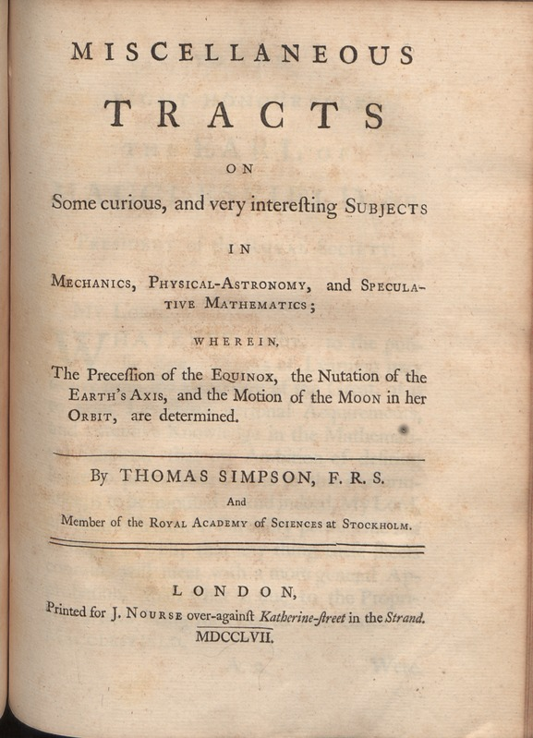

Slide 9
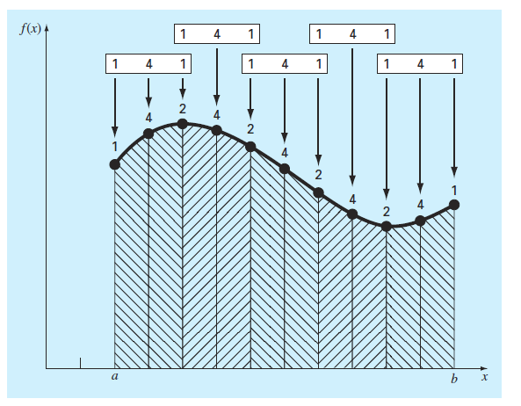
Composite Simpson 1/3 Rule

Slide 10
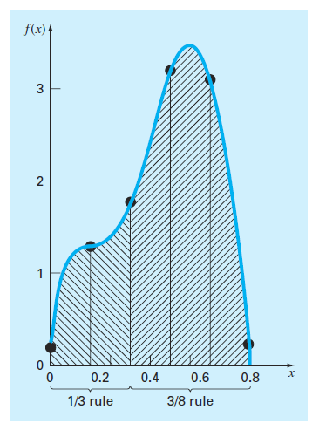
Combining 1/3 and 3/8

Slide 11
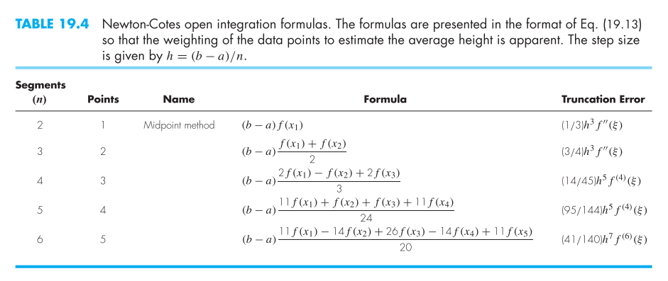
Newton Codes Open Integration Formulas

Slide 12
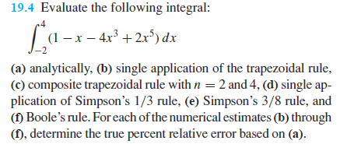
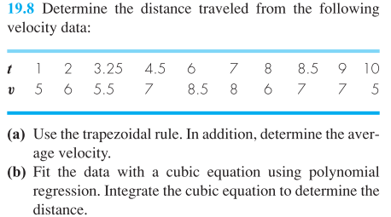
Examples

