Slide 1
Visuals for Class 5
ChE 310
NFR

Slide 2
Example – Failure of Electrical Component
life = [ 6.2 16.1 16.3 19.0 12.2 8.1 8.8 5.9 7.3 8.2 ...
16.1 12.8 9.8 11.3 5.1 10.8 6.7 1.2 8.3 2.3 ...
4.3 2.9 14.8 4.6 3.1 13.6 14.5 5.2 5.7 6.5 ...
5.3 6.4 3.5 11.4 9.3 12.4 18.3 15.9 4.0 10.4 ...
8.7 3.0 12.1 3.9 6.5 3.4 8.5 0.9 9.9 7.9];

Slide 3
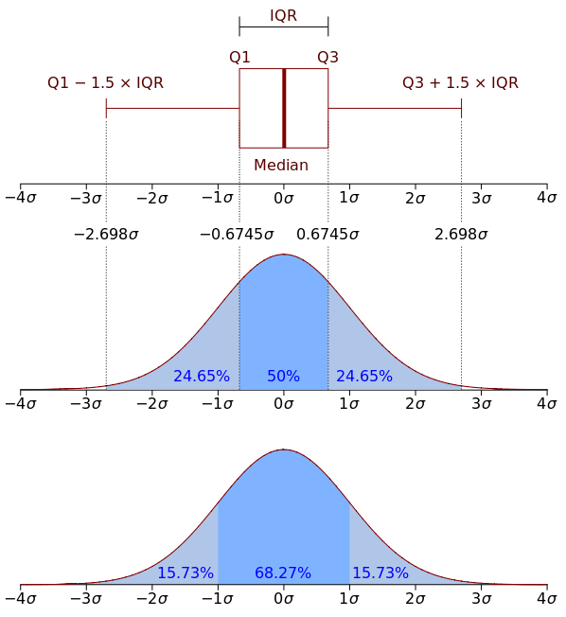

Slide 4
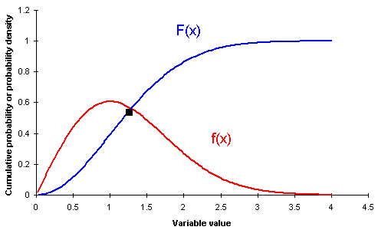

Slide 5
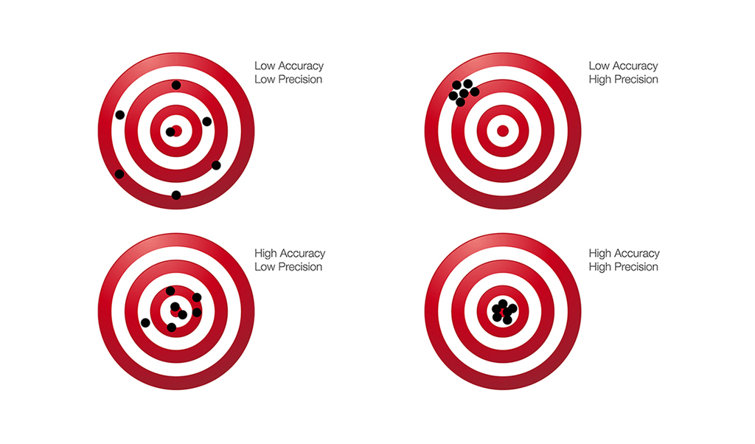

Slide 6
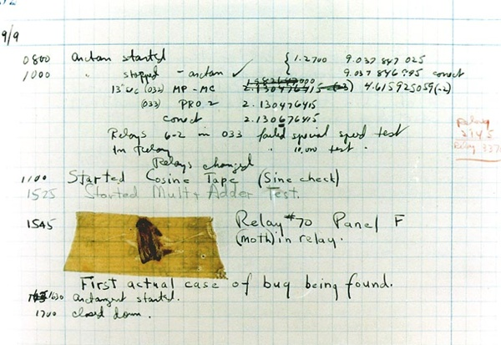
September 9, 1947
At 3:45 p.m., Grace Murray Hopper records the first computer bug in her log book as she worked on the Harvard Mark II. The problem was traced to a moth stuck between a relay in the machine, which Hopper duly taped into the Mark II's log book with the explanation: “First actual case of bug being found.”

